Slide 1
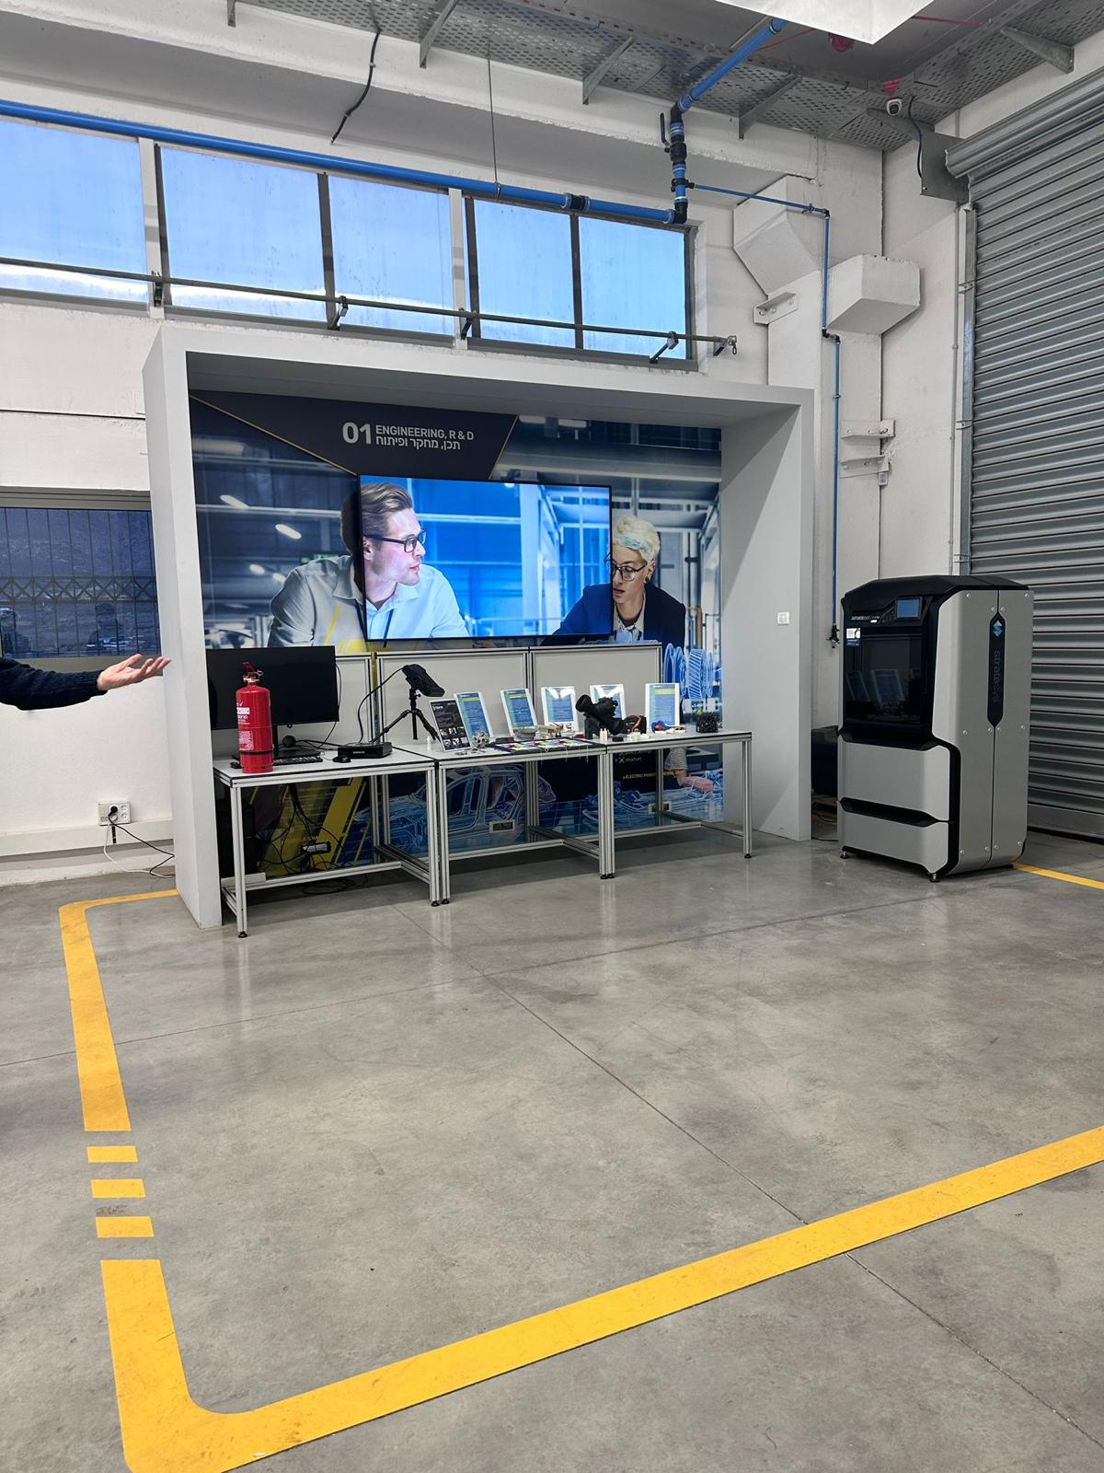







Augmented Reality In Industry 4.0
Second Phase
Supervisor: Dr. Naomi Unkelos Shpigel
Bar Steiner
Ido Saada
1

Slide 2

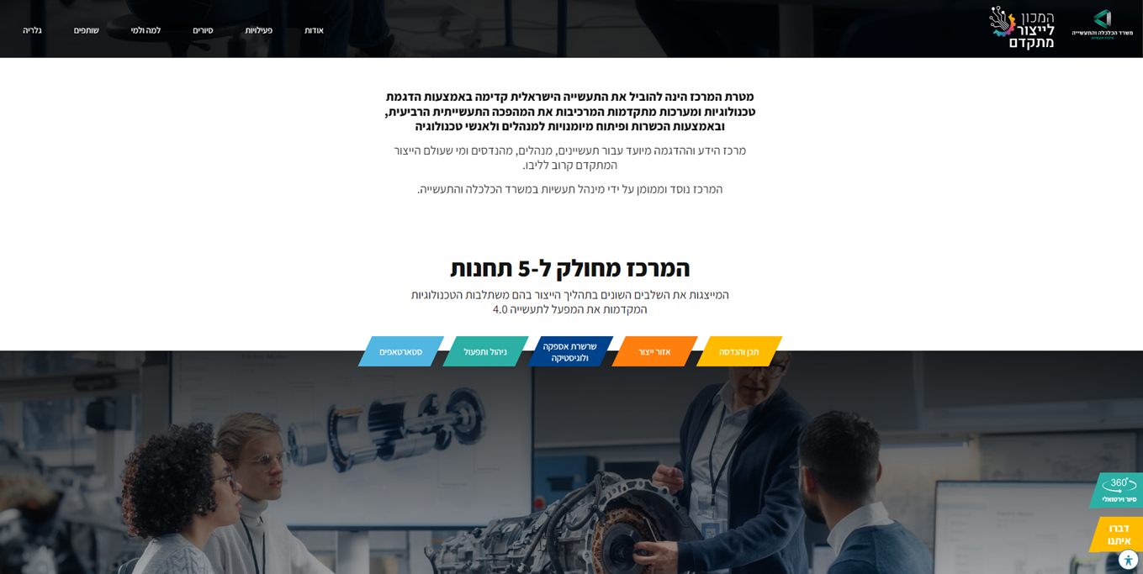
The Problem
The tours at the Institute for Advanced Manufacturing for teenagers are not fascinating enough and fail to generate high levels of involvement among the participants.
2

Slide 3

The Solution
Developedan interactive application for teenagers
3

Slide 4
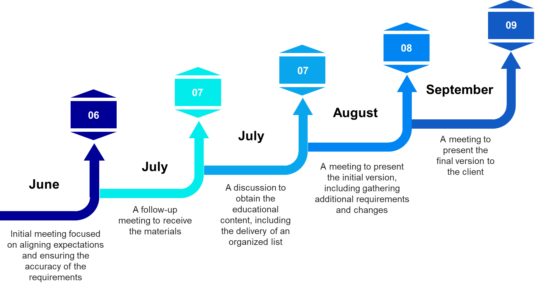
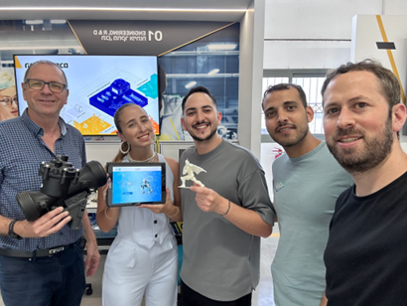
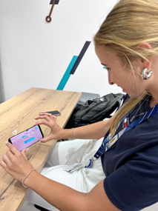
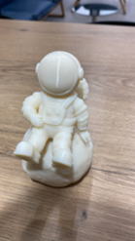
Schedule
5

Slide 5
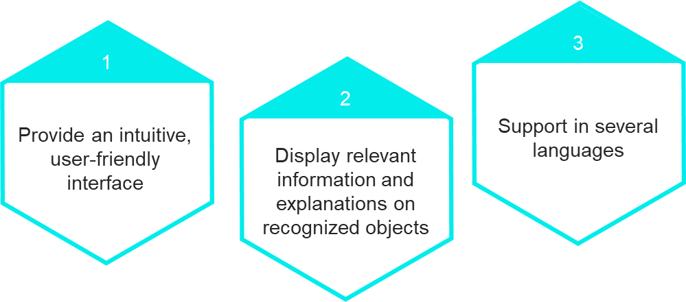
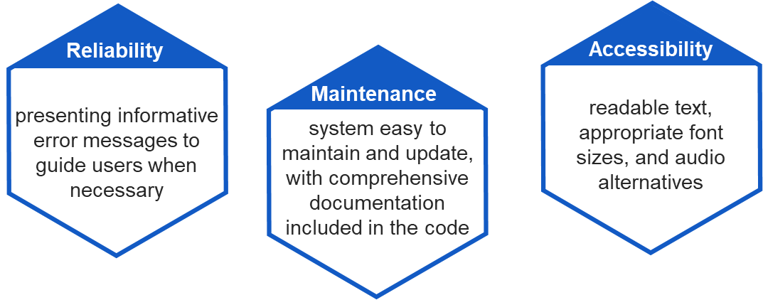
System Requirements
Functional requirements
Non - functional requirements
4

Slide 6
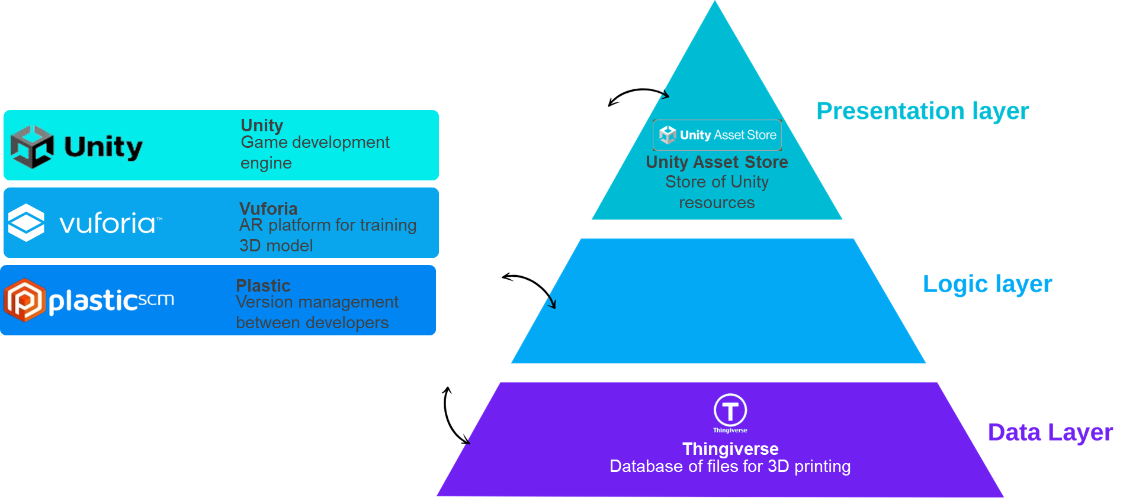
Tools we used
6

Slide 7
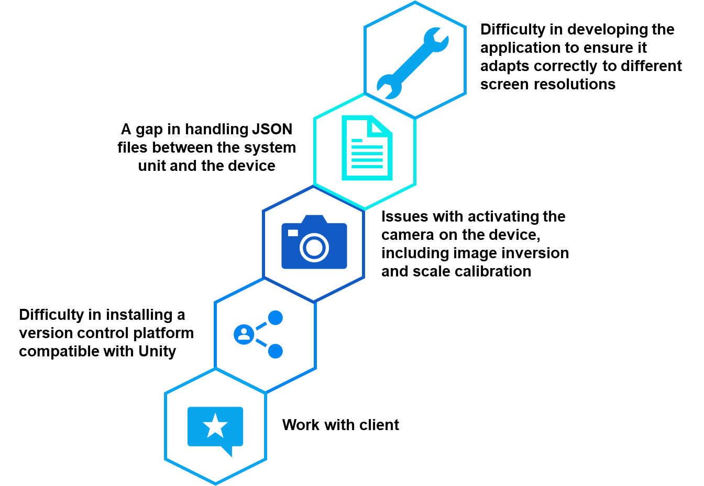
Overcoming Challenges
7

Slide 8
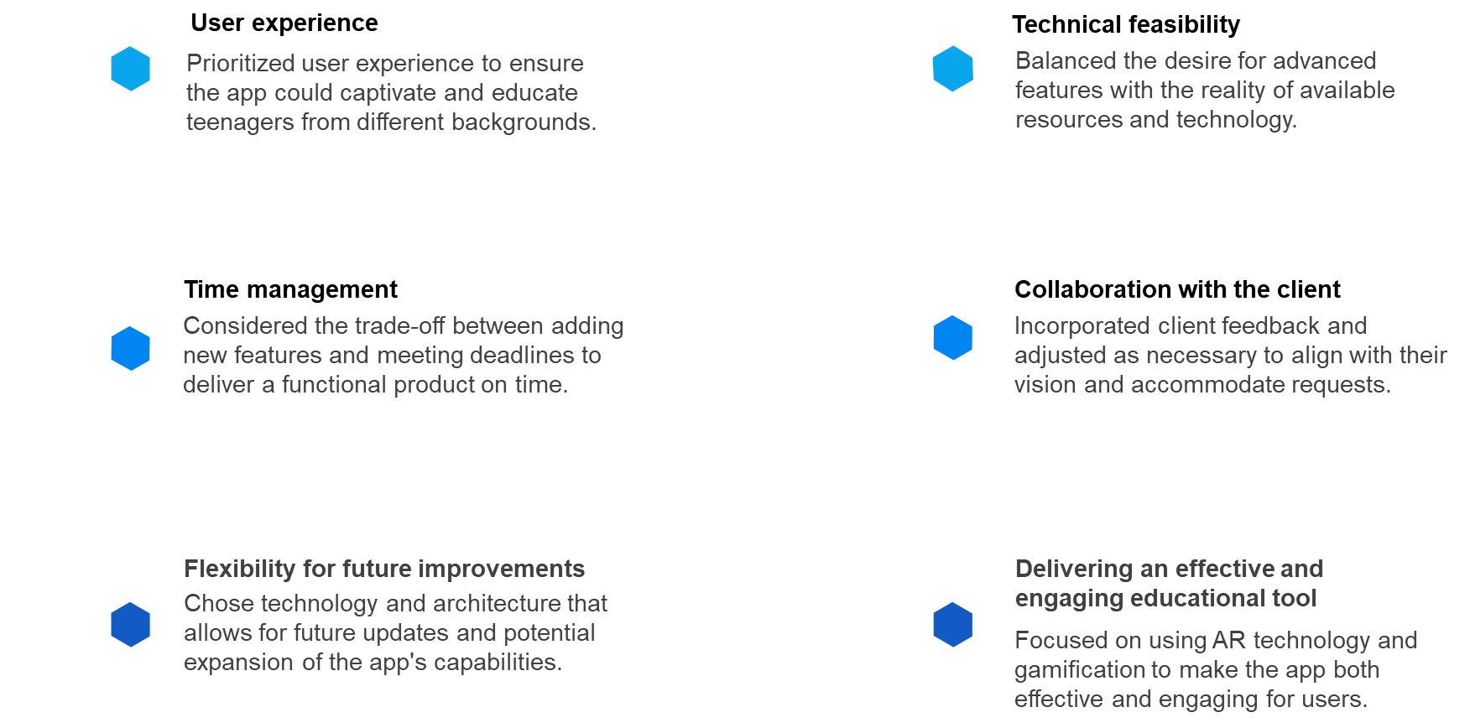
Considerations in Decision Making Throughout the Project
8

Slide 9
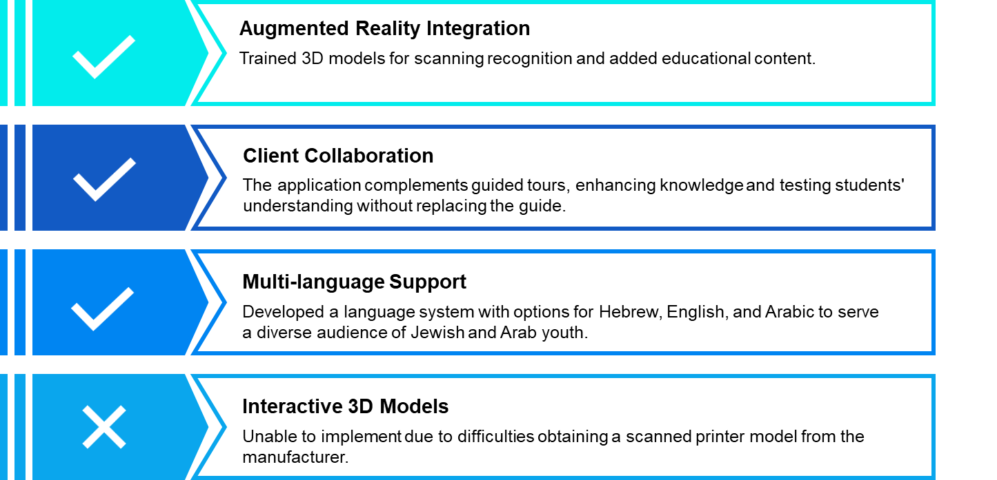
Project Results Analysis and Conclusions
9

Slide 10
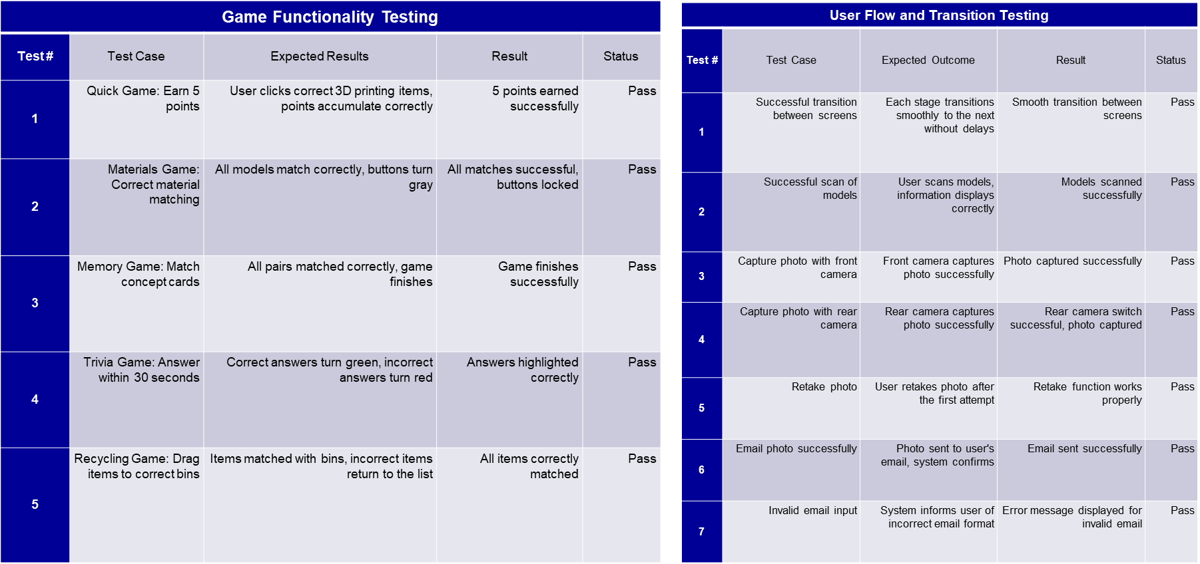
Tests
10

Slide 11
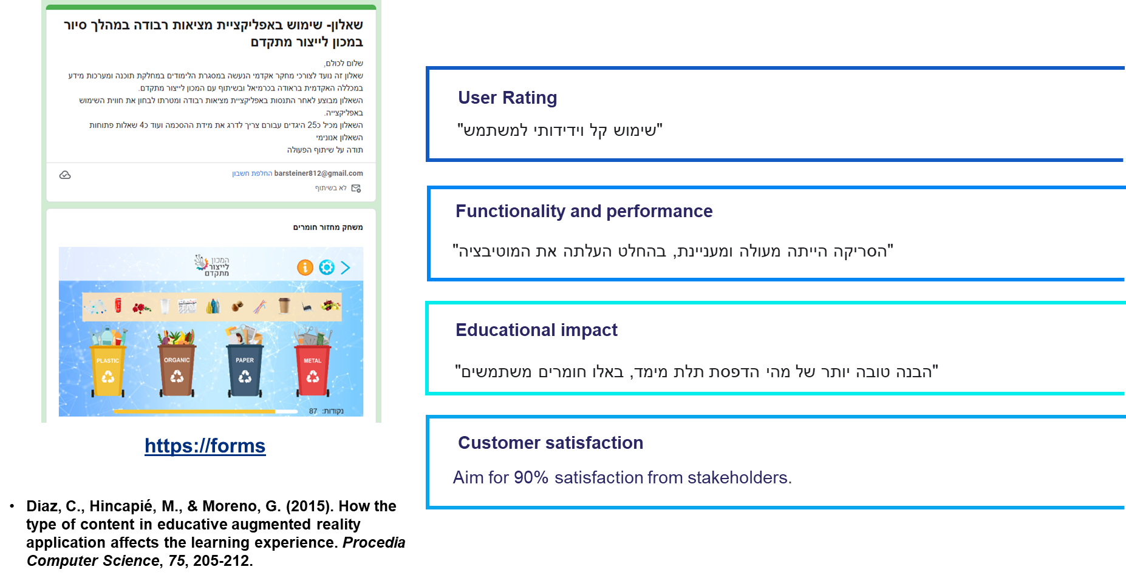

Evaluation
https://docs.google.com/forms
11

Slide 12
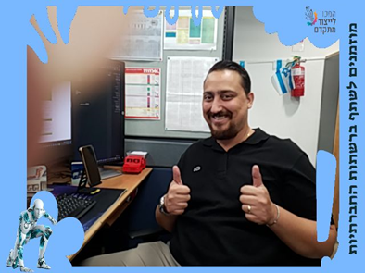
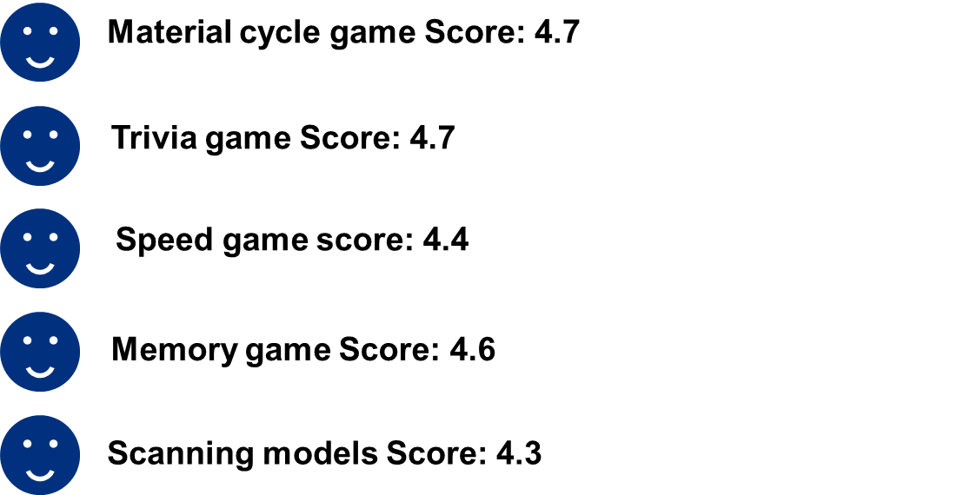
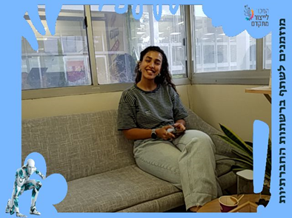
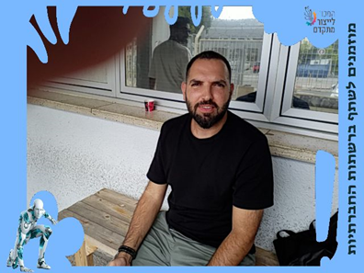
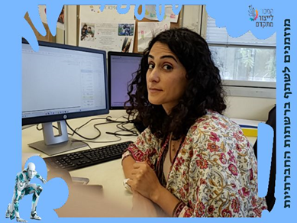

Evaluation of mature users
Average grade: 4.5
12

Slide 13
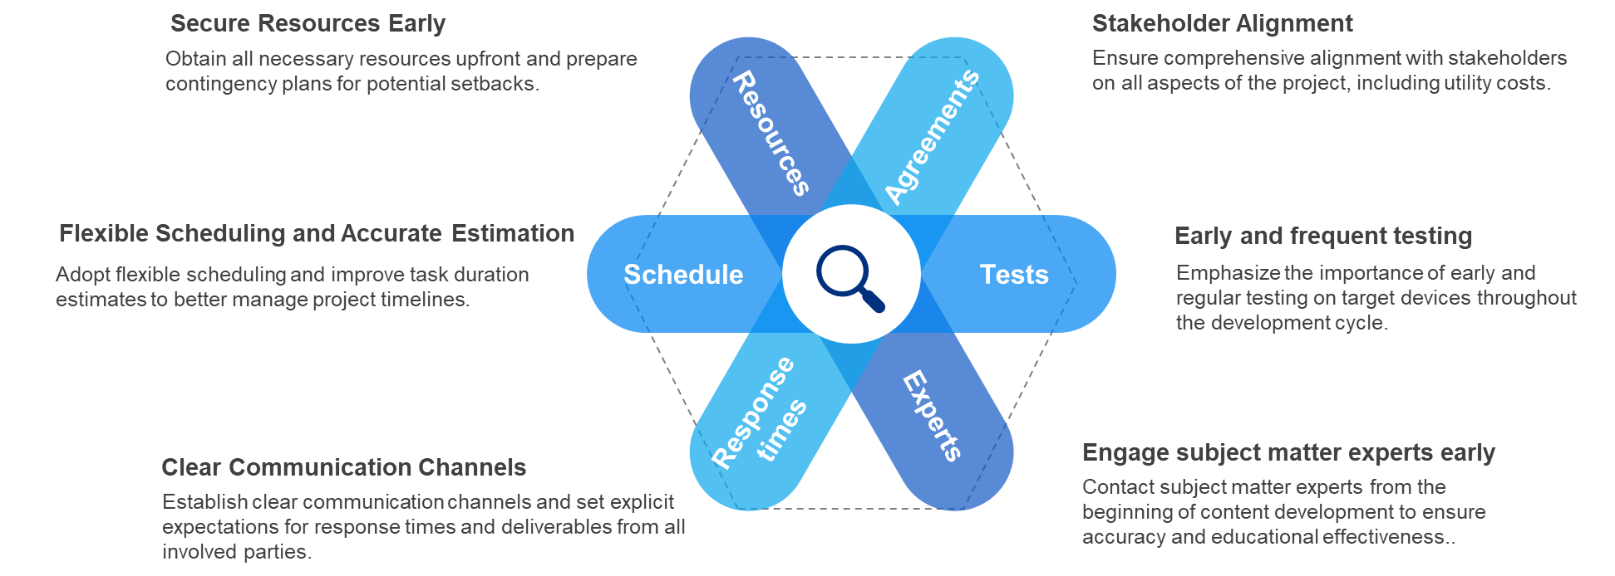
Lessons Learned from the Project
13

Slide 14
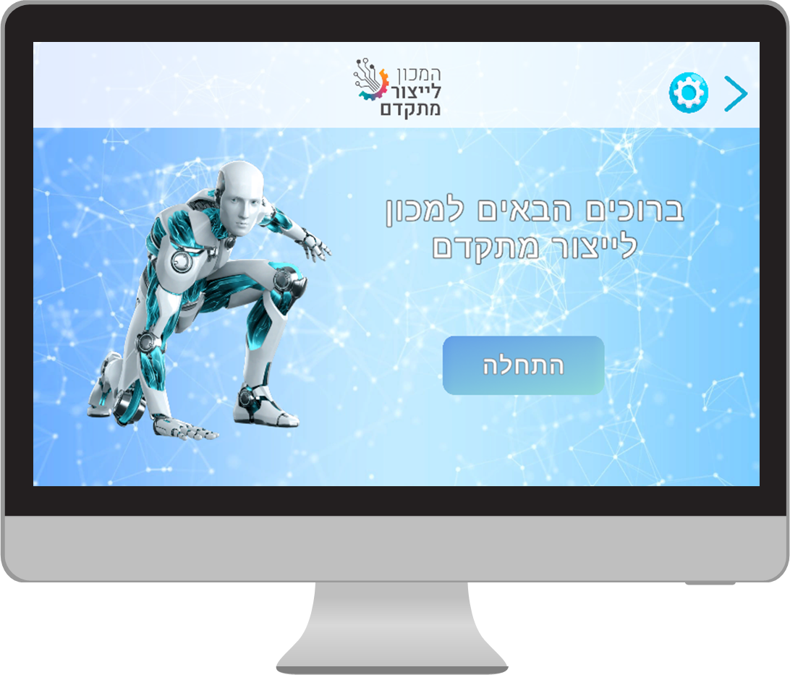
Demo
03
14

Slide 15
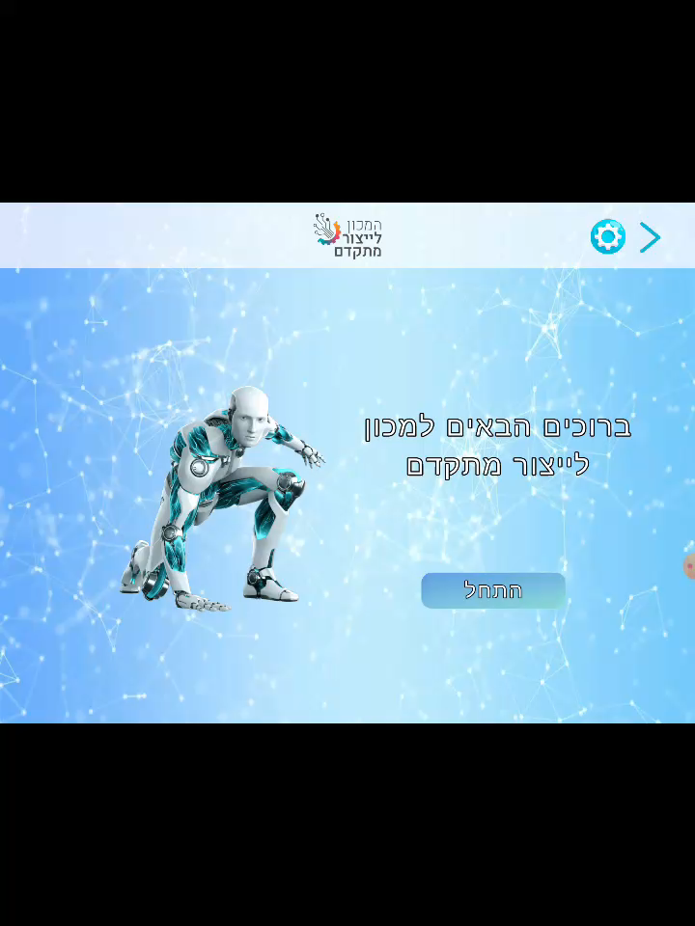
03
14

Slide 16
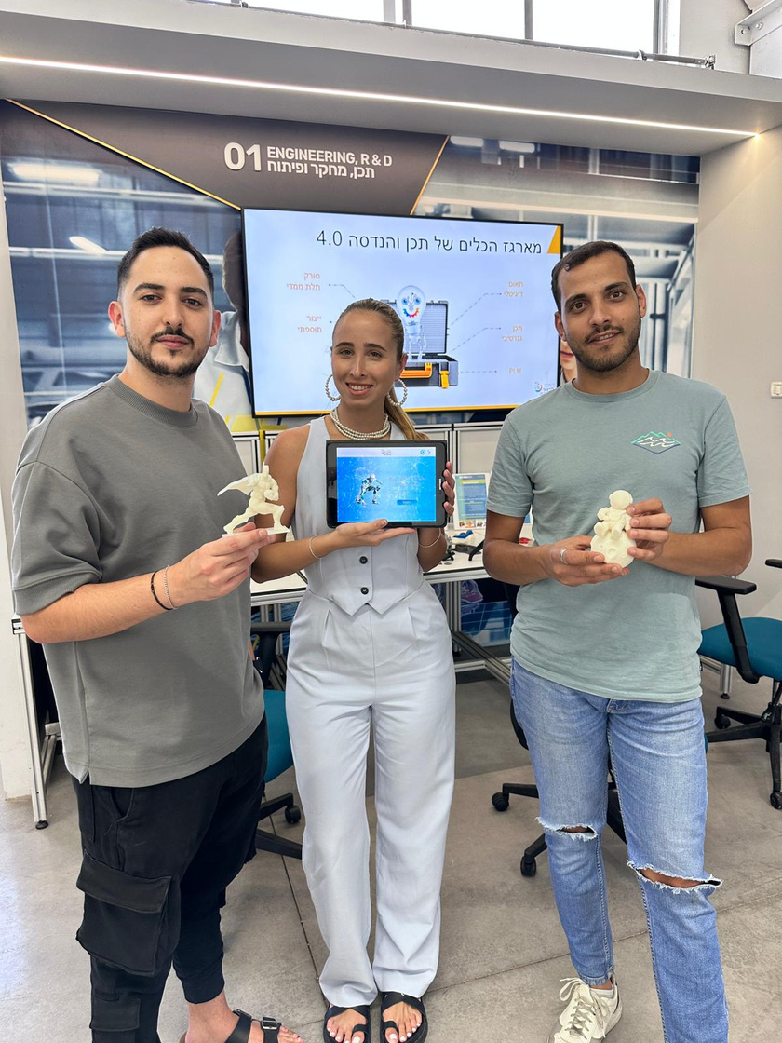
Thank you!
It's time to clap
15

